Slide 1


Project Bicep: ARM Templates Evolved
Sam Cogan
Solution Architect, Willis Towers Watson & Microsoft MVP

Slide 2





About Me
Sam Cogan
Solution Architect – Willis Towers Watson
Microsoft Azure MVP
samcogan.com
@samcogan
sam-cogan

Slide 3
ARM Templates
{
"name": "storageaccount1",
"type": "Microsoft.Storage/storageAccounts",
"apiVersion": "2019-06-01",
"tags": {
"displayName": "storageaccount1"
},
"location": "[resourceGroup().location]",
"kind": "StorageV2",
"sku": {
"name": "Premium_LRS",
"tier": "Premium"
}
}
Notes:
FunctionExamples.json – UniqueString, ResourceGroup, ListKeys, toLower
SaSToken.json – generating a SAS token with ListKeys
Mod.json – using mod to alternate between storage accounts

Slide 4
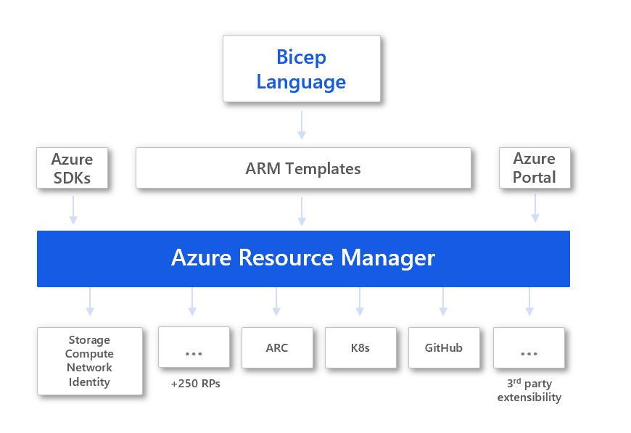
Bicep
Notes:
FunctionExamples.json – UniqueString, ResourceGroup, ListKeys, toLower
SaSToken.json – generating a SAS token with ListKeys
Mod.json – using mod to alternate between storage accounts

Slide 5
Bicep
resource storageaccount1 'Microsoft.Storage/storageAccounts@2019-06-01' ={
name: 'storageaccount1'
kind: 'StorageV2'
location: resourceGroup().location
sku: {
name: 'Standard_LRS'
tier: 'Standard'
}
}
Notes:
FunctionExamples.json – UniqueString, ResourceGroup, ListKeys, toLower
SaSToken.json – generating a SAS token with ListKeys
Mod.json – using mod to alternate between storage accounts

Slide 6

Bicep is currently in preview
It is not ready for production!
There are features in ARM templates that are not yet ready in Bicep:
Copy Loops
Condition Property
Single line Objects and Arrays
Support
Notes:
FunctionExamples.json – UniqueString, ResourceGroup, ListKeys, toLower
SaSToken.json – generating a SAS token with ListKeys
Mod.json – using mod to alternate between storage accounts

Slide 7
Benefits of Bicep
Simpler Syntax
Simple string interpolation – goodbye concat!
Simple resource declaration
Direct property access
Modularisation
Declare parameters, variables, types anywhere
Automatic dependency management (in some scenarios)
Improved validation and Intellisense
Notes:
FunctionExamples.json – UniqueString, ResourceGroup, ListKeys, toLower
SaSToken.json – generating a SAS token with ListKeys
Mod.json – using mod to alternate between storage accounts

Slide 8
Demo
Using Bicep

Slide 9
Custom Modules
module stgacct './storage_module.bicep' ={
name: 'storageaccount'
params: {
storageAccountName: '${prefix}stg'
}
}
Notes:
FunctionExamples.json – UniqueString, ResourceGroup, ListKeys, toLower
SaSToken.json – generating a SAS token with ListKeys
Mod.json – using mod to alternate between storage accounts

Slide 10
Demo
Modules

Slide 11

Migrating to Bicep
Manual conversion
Decompile an ARM Template
bicep decompile "path/to/file.json"
Decompile a Resource Group
az group export --name "your_resource_group_name" > main.json
bicep decompile main.json
Notes:
FunctionExamples.json – UniqueString, ResourceGroup, ListKeys, toLower
SaSToken.json – generating a SAS token with ListKeys
Mod.json – using mod to alternate between storage accounts

Slide 12
Demo
Migration

Slide 13

Why Use Bicep?
New users coming to IaC in Azure for the first time
Existing ARM users wanting a simpler language
Existing ARM users wanting new language features
Access to the latest Azure resources fastest
Support from Microsoft
Notes:
FunctionExamples.json – UniqueString, ResourceGroup, ListKeys, toLower
SaSToken.json – generating a SAS token with ListKeys
Mod.json – using mod to alternate between storage accounts

Slide 14
IaC Tooling Comparison
 | ARM Templates | Bicep | Terraform | Pulumi
Languages | JSON | Custom DSL | Custom DSL (HCL) | Node JS (TS, JS), Python, .NET Core, GO
Complexity | High | Medium | High | High
Speed Of Update | Fast | Fast | Slower | Slower
Multi Cloud | No | No | Yes | Yes
Stateful | No | No | Yes | Yes
Open Source | No | Yes* | Yes | Yes
Support | Microsoft | Community (until 0.3) | Community/Paid | Community/Paid
Additional Features | Policy (separate service) | Policy (separate service) | Cloud State Policy & Governance Module Repository Web Portal Cost Estimation | Cloud State Policy & Governance Web Portal
Notes:
FunctionExamples.json – UniqueString, ResourceGroup, ListKeys, toLower
SaSToken.json – generating a SAS token with ListKeys
Mod.json – using mod to alternate between storage accounts

Slide 15

Useful Resources
Bicep GitHub Repository - https://cogan.to/rtj
Bicep Tutorial - https://cogan.to/c5t
Introduction to Bicep - https://cogan.to/x6t
These slides and demos - https://cogan.to/an9
Notes:
FunctionExamples.json – UniqueString, ResourceGroup, ListKeys, toLower
SaSToken.json – generating a SAS token with ListKeys
Mod.json – using mod to alternate between storage accounts

Slide 16
About Me
Sam Cogan
Solution Architect – Willis Towers Watson
Microsoft Azure MVP
samcogan.com
@samcogan
sam-cogan

